Slide 1
EDA CONTEST
HR PROJECT
Name: Jay Ganesh Charole
Email: jaycharole@gmail.com

Slide 2
CONTENTS
About the project
About the Data
Insights to find?
1
A detailed description about the project.
2
Introduction to data set that is been used for project.
3
What are the objectives and insights that are to be found out?
Steps for EDA and cleaning data
Visual analytics
Key Findings
4
Various steps used for data cleaning and EDA process.
5
Different visuals and summaries to understand data well
6
Insights we found out according to various questions.
Dashboard view
7
The view of dashboard that is been created

Slide 3
1
ABOUT THE PROJECT

Slide 4
ABOUT PROJECT
Every company has a HR Department which deals with various recruitment and placement related work of the company. Here in this project we have a huge data set in from which we are going to extract insights which can be useful for HR department to work on and to gain knowledge about the recruitment process of the market. We have extracted many different insights which we will observe further in the report.

Slide 5
2
ABOUT THE DATA

Slide 6
ABOUT DATA SET
The dataset is about the job details data for analytics industry. The companies in the dataset are Hong Kong based companies. Data consist of various job description for various analytics job roles like Data Scientist, Data analyst, Business Intelligence, Machine Learning Engineer, Data Engineer. The Dashboard made at the end is for the HR Team of a company.
The dataset has 6 separate dataset of different days which was combined to make a final data set. It is a huge dataset with many columns and other attributes

Slide 7
DETAILS OF DATASET
1
JOB TITLE
The Job Title column contains the name of the jobs given by a particular company.
2
COMPANY
The Company column contains the name of the companies who are providing different types of jobs.
3
SALARY
The Salary column contains the salary for various job roles. Salary column has many null values as many companies do not reveal their salaries publicly.
4
JOB DESCRIPTION
The Job Description column contains the detailed description of the job given by particular companies providing the jobs.
5
CAREER LEVEL
The column contains various career levels like Entry Level, middle level, senior level, etc. based on number of years of experience.

Slide 8
DETAILS OF DATASET
6
QUALIFICATION
The Qualification column contains various educational qualification an individual need for a job for example degree, graduation, post graduation, etc.
7
YEARS OF EXPERIENCE
The Years of Experience column contains the minimum eligibility in terms of experience of years for various job roles
8
JOB TYPE
The Job Type column contains the type of jobs required for example full time, internship, part time, contract, etc.
9
COMPANY WEBSITE
In the company website there are various website links where an individual can apply.
10
INDUSTRY
The Industry column is the domain to which a particular job role belongs for example Finance, HR, IT, etc.

Slide 9
DETAILS OF DATASET
11
SEARCH TERM
The Search Term is the column which contains various analytics domain job belongs to for example Data Science, Data Analytics, BI, ML, etc.
12
DATE POSTED
The Date posted column contains the date when a particular job was posted.
13
DATE SCRAPPED
The Date scrapped column contains the date when the particular dataset was scrapped from some recruitment websites..

Slide 10
INSIGHTS TO
FIND OUT?
3

Slide 11
INSIGHTS TO BE FOUND?
1
What are total number of jobs available?
2
What are total number of companies providing jobs?
3
What are total jobs for various domains?
4
What are various career level and it’s distribution across various jobs?
5
What are distribution of jobs across various analytics fields?

Slide 12
INSIGHTS TO BE FOUND?
6
Which company is providing highest number of jobs?
7
Which domain has the highest number of jobs?
8
What are minimum required qualification for job roles?
9
What are various job types for different job titles?
10
Which are TOP 5 companies with highest jobs?

Slide 13
STEPS FOR CLEANING DATA AND EDA
4

Slide 14
1. REMOVING UNECESSARY COLUMNS
1
REMOVING LOWER SALARY RANGE & UPPER SALARY RANGE
The column is of no use hence we can replace the columns using remove column option of Power BI.
2
REMOVING DATE SOURCE COLUMN
The column is of no use hence we can replace the columns using remove column option of Power BI.

Slide 15
2. REMOVING NULL VALUES AND ERRORS
1
REMOVING NULL VALUES AND ERRORS AND MISSING VALUES FROM COLUMNS
There are various null values, errors and missing values in the columns which we can delete using various options in Power BI.
2
REMOVING NOT SPECIFIED VALUES FROM THE COLUMNS
There are many columns which has the value Not Specified values which are of no use and can create problem while changing data types and other calculations hence we will remove that values from the data set.

Slide 16
3. CHANGING DATA TYPES
1
CHANGING DATA TYPE OF YEAR OF EXPERIENCE
The column was having a string data type hence we can change it to whole number using change data type option.
2
CHANGING DATA TYPE OF DATE COLUMNS The data formats were in string type hence we have changed it to date type using change data type option

Slide 17
4. REPLACING VALUES
1
REPLACING VALUES IN EXPERIENCE COLUMN
The Experience table was having a value -1 which was suppose to be 1 so changed the value -1 to 1 using Replace Value option.
2
REPLACING VALUE IN QUALIFICATION COLUMN
The Qualification column has two qualification name Non-Degree Tertiary and Non Degree Tertiary so we can replace Non Degree Tertiary with Non-Degree Tertiary as they represent same qualification.
3
JOB TYPE
The Job Type column contains the type of jobs required for example full time, internship, part time, contract, etc.

Slide 18
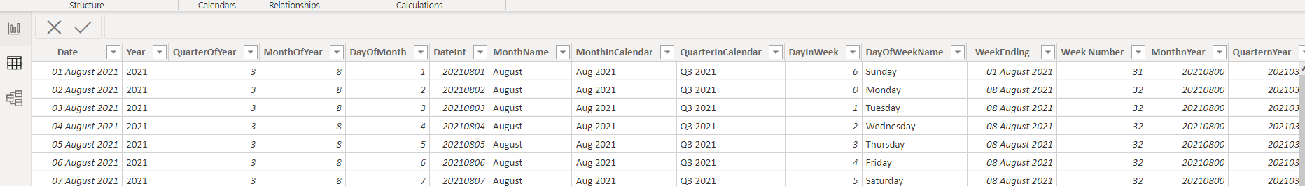
5. CREATING DATE TABLE USING M LANGUAGE
1
CREATING DATE TABLE USING M LANGUAGE
We need a date table to perform date operations hence we can create Date Table using the following code.

Slide 19
VISUAL ANALYTICS AND FINDINGS
5

Slide 20
SUMMARY OF DATA
Total number of jobs
Total companies
1979
719
Total industry
50
There are different jobs available and various companies and industries. The summary below shows the Total summaries.

Slide 21
SUMMARY OF DATA
Total Career Level
Total analytics field
3
5
Total Job Types
35
There are various job titles similarly there are various Career level, various fields of job and various job types which is been shown below.

Slide 22


COMPANY AND DOMAIN WITH
HIGHEST NUMBER OF JOBS
HKT and Michael Page are the companies with highest number of Job Titles. They both have 25 jobs.
Human Resources Management/Consultancy is the domain with highest number of jobs, with 482 different jobs.

Slide 23
TOP 5 COMPANIES AND TOTAL JOBS
RANK | NAME OF THE COMPANIES | TOTAL JOBS
1 | HKT, Michael Page | 25
2 | Robert Walters (HK) | 24
3 | Page Group Hong Kong | 23
4 | Dah Sing Financial Group | 19
5 | Walters People | 18

Slide 24
CAREER LEVEL
Career level is the type of job work you are going to get according to years of experience you have.
Total Career Level
There are three types of Career Level that are:
3
1
Entry Level Jobs
Entry level jobs are the job level for fresher's or people entering a new domain.
1
Middle Level Jobs
Middle level jobs are the job level for the people with some years of experience in a particular domain.
1
Senior Level Jobs
Senior Level jobs are the job level for the people who have many years of experience in particular domain and they can work for higher job post like manager, etc.

Slide 25
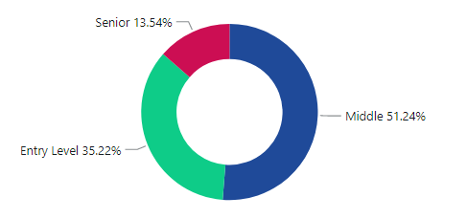
VARIOUS JOB TYPES FOR
DIFFERENT JOB TITLES
KEY INSIGHTS
There are various career level according to requirement of the job. Career level depends upon the years of experience of an individual.
According to the visual Entry Level Jobs shares 35.22% of job share. Middle Level Jobs has the highest shares with 51.24%. Senior Level Jobs has 13.54%.
Companies has various job types for various job titles.

Slide 26
VARIOUS JOB TYPES FOR DIFFERENT JOB TITLES
Career Level
Entry Level Jobs
Middle Level Jobs
Senior Level Jobs
Total Entry Level Jobs
Total Middle Level Jobs
Total Senior Level Jobs
Decision
Knowledge
697
1014
268

Slide 27



ENTRY LEVEL JOBS
Company with highest number of Entry Level job is China Mobile Hong Kong, with 10 Entry Level Jobs.
Education industry has highest number of Entry Level job, with 10 entry level jobs.
MIDDLE LEVEL JOBS
Company with highest number of Middle Level job is Ambition, with 9 Middle Level Jobs.
Accounting/Audit/Tax services has highest number of Middle Level job, with 17 Middle level jobs.
SENIOR LEVEL JOBS
Company with highest number of Senior Level job is A.S. Watson Retail (HK) Limited , with 5 Senior Level Jobs.
Banking industry has highest number of Senior Level job, with 6 Senior level jobs.

Slide 28
JOB ROLES LEVEL
Total Analytics field
There are five types of Career Level that are:
5
1
Data Scientist Jobs
2
Data Analyst Jobs
3
Data Engineer Jobs
4
Business Intelligence Jobs
5
Machine Learning Engineer Jobs

Slide 29
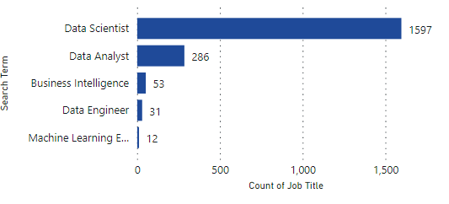
JOB ROLE ANALYSIS
Data Science
1597
Data Analyst
286
Business Intell..
53
Data Engineer
31
KEY INSIGHTS
From the above graph we can observe that the Data Scientist has highest number of job roles with 1597 jobs and Machine Learning Engineer has least that is 12 jobs. Second highest is data analyst with 286 job roles. Business Intelligence and Data Engineer are close with 53 and 31 job roles.
ML Engineer
12

Slide 30





COMPANY WISE INSIGHTS
IT solutions Limited is the highest which has 21 job opening in data science role.
PERSOKELLY HongKong is the highest which has 6 job opening in data analyst role.
Many industries has only single job requirement in data engineer job role.
Many industries has only single job requirement in data engineer job role.
Many industries has only single job requirement in business intelligence job role.
KEY INSIGHTS
Most of the companies prefer Data Scientist and Data analyst jobs because rest of the job roles are covered in both the job roles

Slide 31
DOMAIN WISE INSIGHTS
Information Technology domain is the highest which has 375 job opening in data science job role.
Human Resources/Consultancy domain is the highest which has 97 job opening in data analyst job role.
Tellecomunnication domain is the highest which has 7 job opening in data engineer job role.
Information Technology domain is the highest which has 4 job opening in machine learning engineer role.
Financial Services domain is the highest which has 4 job opening in business intelligence role.

Slide 32
ENTRY LEVEL WISE INSIGHTS
Data Scientist has 564 entry level jobs with Manpower services HongKong has highest jobs.
Data Analyst has 105 entry level jobs with ATAL Engineering having the highest..
Data Engineering has 13 entry level jobs with HGC Global Communication limited having the highest jobs.
Machine Learning Engineering has 4 entry level jobs.
Business Intelligence has 10 entry level jobs.

Slide 33
MIDDLE LEVEL WISE INSIGHTS
Data Scientist has 822 middle level jobs with IT Solution Limited having highest jobs.
Data Analyst has 136 middle level jobs with Randstad HongKong having the highest..
Data Engineering has 16 middle level jobs.
Machine Learning Engineering has 7 middle level jobs.
Business Intelligence has 33 middle level jobs.

Slide 34
SENIOR LEVEL WISE INSIGHTS
Data Scientist has 211 senior level jobs with Michael Page having highest jobs.
Data Analyst has 45 senior level jobs.
Business Intelligence has 10 senior level jobs.

Slide 35
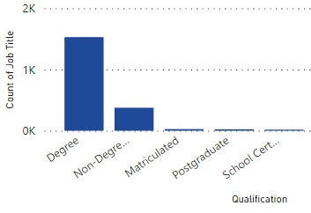
REQUIRED QUALIFICATION FOR JOBS
Many people takes a degree or post graduation degree for jobs. Lets study the distribution of various companies across various qualification.
KEY INSIGHTS
From the above visual we can observe that the more companies require a Degree for various roles. Comparison to Non-Degree its not even half of the Degree. There are also other qualification involved such as Matriculated, Post Graduation and School Certificates.

Slide 36
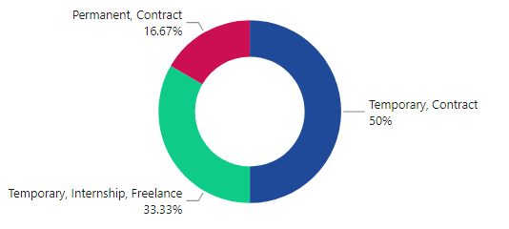
VARIOUS JOB TYPES FOR DIFFERENT JOB TITLES
Companies has various job types for various job titles.
KEY INSIGHTS
There are various job types like permanent jobs, temporary jobs, contract based jobs, freelancing, internships, etc.
The visuals shows the distribution of various job roles across various job titles. 50% of Jobs are Temporary and Contract based. 33.33% jobs are Temporary, Internship and Freelancing jobs. Permanent Contract based jobs have 16.67% share.

Slide 37
6
KEY INSIGHTS

Slide 38
INSIGHTS TO BE FOUND?
1
There are 1979 jobs available.
2
719 companies are providing jobs.
There are around 50 different domains in which jobs are provided
3
4
HKT and Michael Page are the companies which has highest job opening.
5
Human Resources Management/Consulting is the domain which has highest number of jobs.

Slide 39
INSIGHTS TO BE FOUND?
6
Middle level jobs has the highest opening with 1014 jobs.
Data Science has highest job titles followed by Data analyst.
7
8
ML Engineer has the least job titles.
9
Most companies prefer individuals with degree for their job roles
10
Most job types are temporary contract based.

Slide 40
7
DASHBOARD

Slide 41
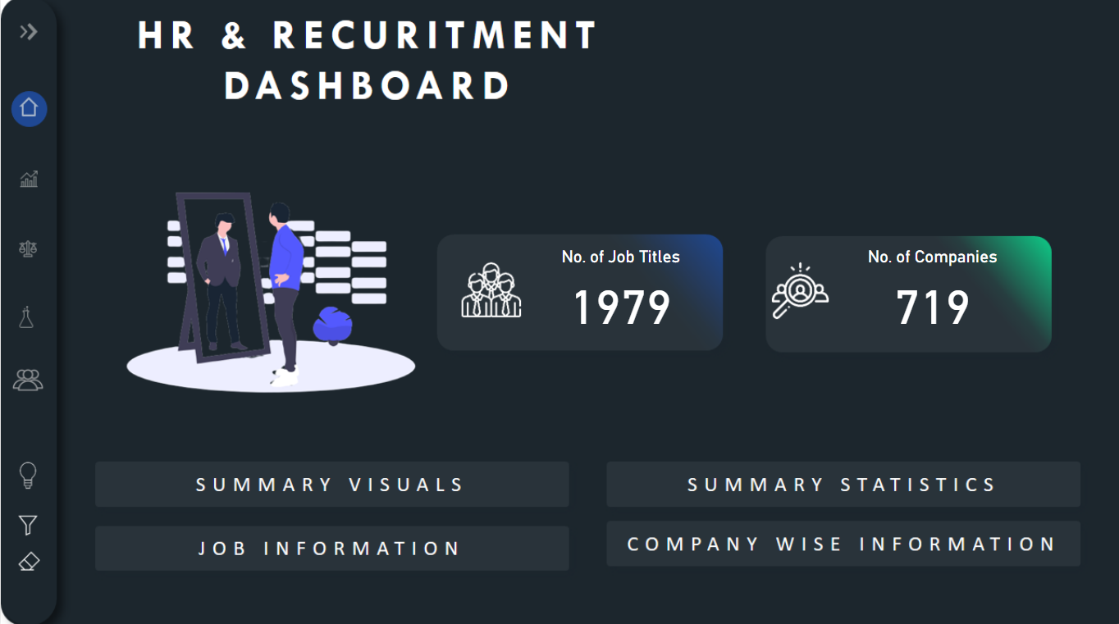
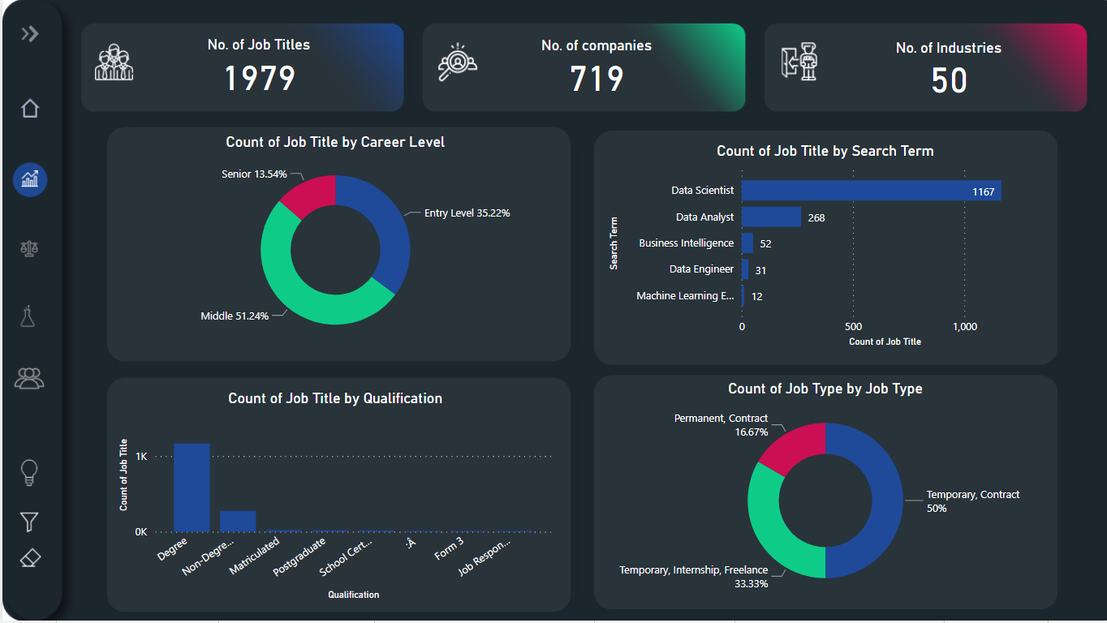
DASHBOARD PAGES VIEW
HOME PAGE OF THE DASHBOARD
SUMMARY VISUAL PAGE

Slide 42
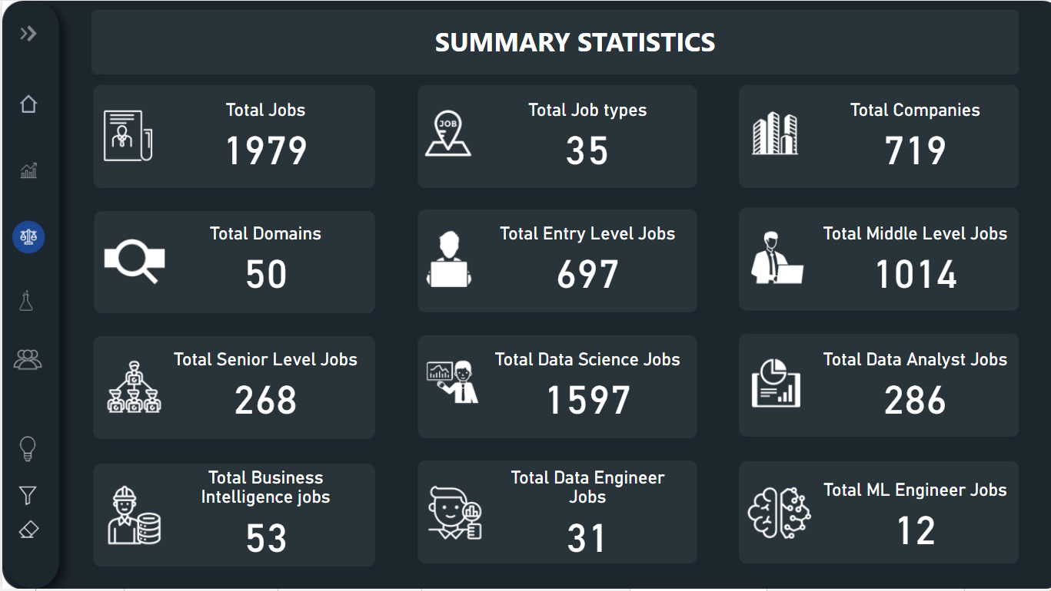
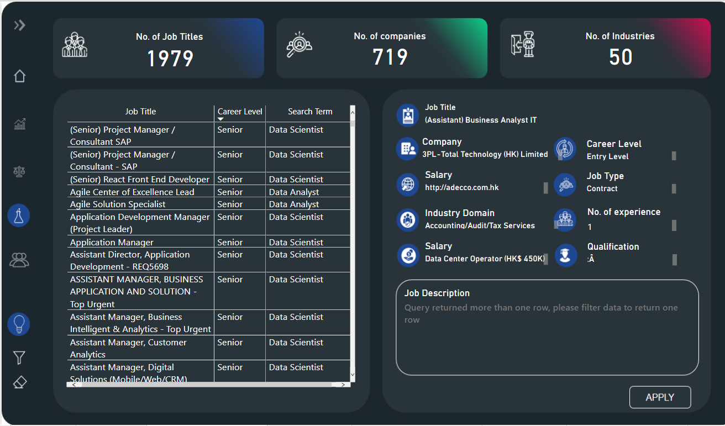
DASHBOARD PAGES VIEW
SUMMARY STATISTICS PAGE
JOB SUMMARY PAGE

Slide 43
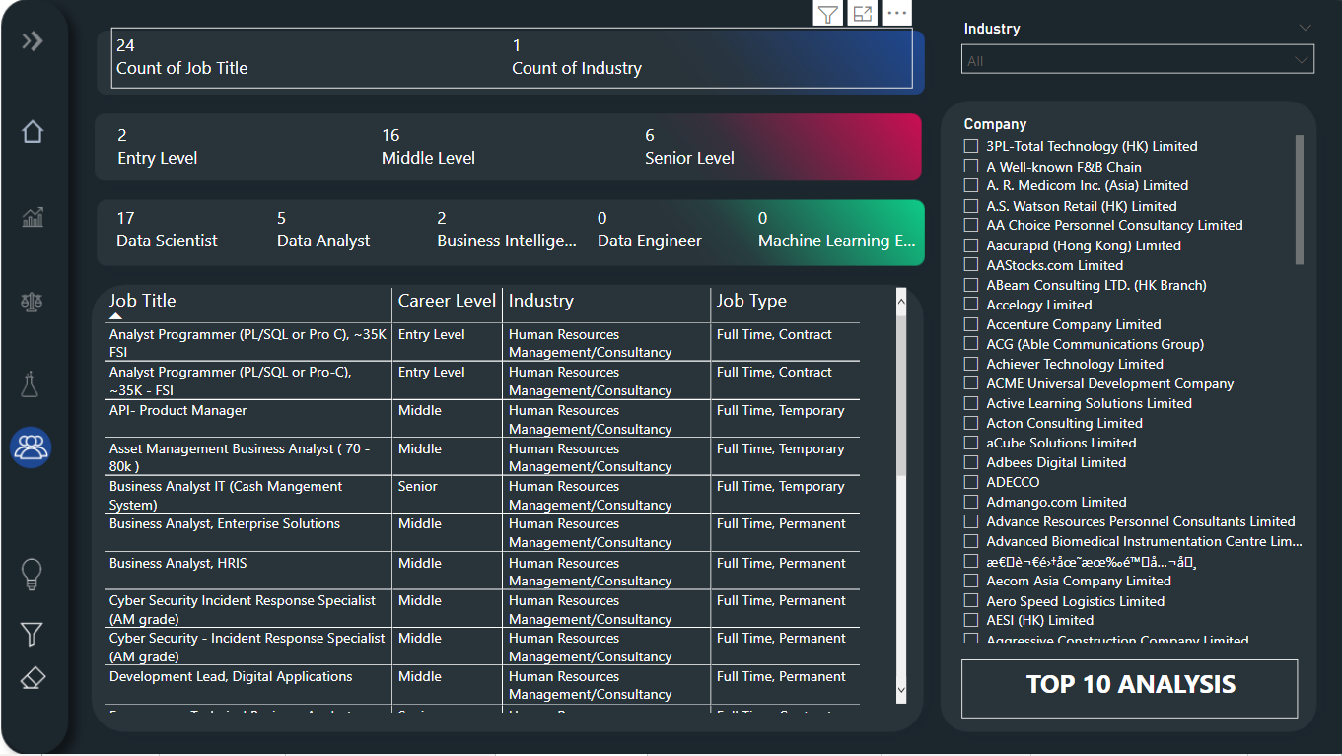
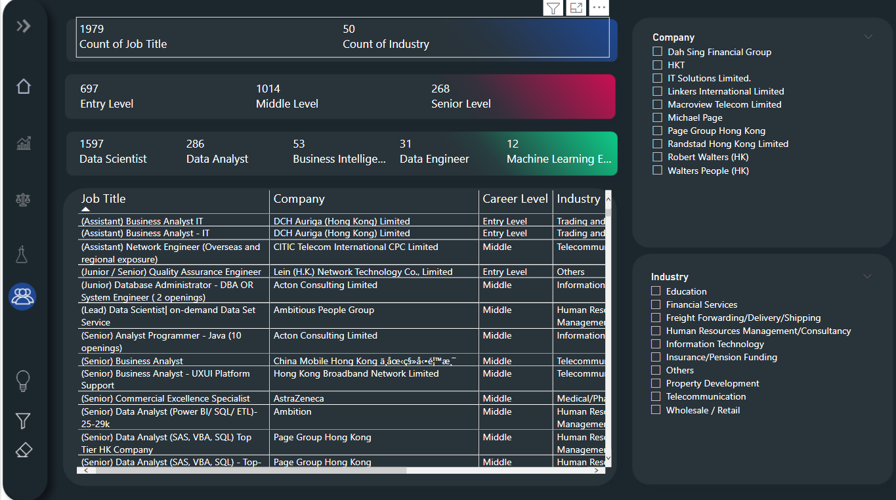
DASHBOARD PAGES VIEW
COMPANY LEVEL ANALYSIS PAGE
TOP 10 COMPANY LEVEL ANALYSIS PAGE

Slide 44

/
THANK YOU !
A very special thanks to Satyajit Sir for organizing this amazing contest.
CONTACT AND SOCIAL LINKS
Email: jaycharole@gmail.com
Contact: 9892968944

